Slide 1
Office CORP TRIAL CAMPAIGN ANALYSIS AND RECCOMENDATIONS
BY KARL KUELLMER

Slide 2
Office Corp trial campaign analysis
Contents:
Background
Data provided
Objectives
Methodology
Exploratory Data Analysis (EDA)
Models
Lift Chart
Summary and Recommendations
Appendix 1 Models
Appendix 2 Comparison of Data

Slide 3
Office Corp trial campaign analysis
Background
Office Corp has executed a trial marketing campaign of 16,000 clients
Client wants to use response data from trial campaign to selectively target customers and increase profitability and efficiency when campaign is scaled up to 100,000 clients

Slide 4
Office Corp trial campaign analysis
Data Provided:
Trial Campaign results
Historical sales
Number of prior year transactions
# of Employees
Prior products purchased
Date of first purchase
Method of contact and response
Language

Slide 5
Office Corp trial campaign analysis
Objectives:
Trial Campaign
-> Provides Material for Model
-> Model selectively chooses targeted customers
-> Targeting Customers Maximizes Profits
for Full Scale Campaign

Slide 6
Office Corp trial campaign analysis
Methodology
EDA - Examine data for important features. Clean and transfom Data
Explore different model type to see which type best applies to data
Gradient Boosting Classifier to determine probability of response
Linear Regression to determine likely size of purchase
Calculate profitability based on regression outputs,
gross margin, and campaign and transaction cost
Define customer deciles
Create lift table
Deliver recommendation

Slide 7
Office Corp trial campaign analysis
EDA – Exploratory Data Analysis
Removed outliers in # of prior year transactions
Created binary variable for ‘Has Campaign Sales’
Feature engineering:
Tenure (turned into four groups)
All product variables changed to binary
Digitized the categorical Company Size (1-5 becomes 3, 6-10 became 8, etc.) Filled in missing values with 8, as this is by far the most common size of company (value for 25th and 50th percentile)
Consolidation
Removed columns that added no information to the models (such as Language)
Campaign sales & historical sales volume
Removed negatives
Removed customers with first purchases older than Office Corp

Slide 8
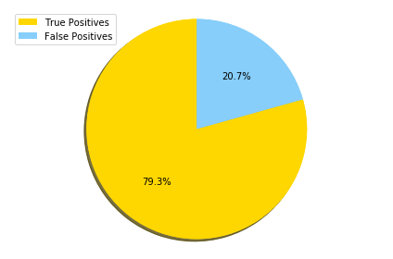
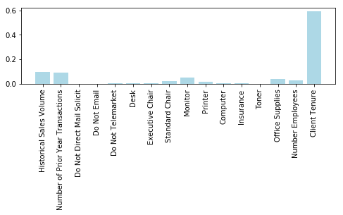
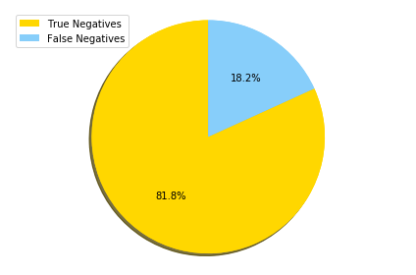
Office Corp trial campaign analysis
Gradient Boosting Classifier (Model 1)
Predicts whether or not customer will buy
Gradient Boosting Classifier (Model 1)
Independent Validation Sample Size: 6060
Predicted Buyers
Relative Importance of Features
Predicted Non Buyers

Slide 9
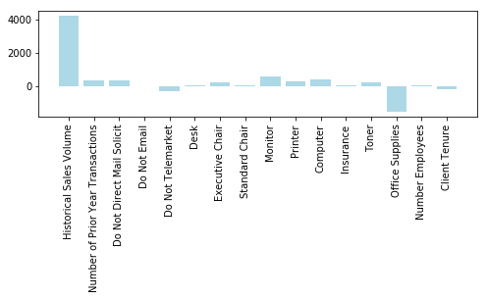
Office Corp trial campaign analysis
Linear Regression (Model 2)
Predicts Expected Size of Purchase
Trained on subset of Actual Buyers from 6060 used in Model 1

Slide 10

Office Corp trial campaign analysis
Profitability Model
Profitability Calculation:
Gross Margin on Sales: 22%
Campaign Cost: $45.65 per business contacted
Transaction Cost: $8.40 per transaction
$$E\left(Profit\right)= .22∗Prob\left(Sale\right)∗Est\left(Transaction Size\right)$$
$$−\$8.40∗Prob\left(Sale\right)−\$45.65$$

Slide 11
Office Corp trial campaign analysis
Summary and Results
Summary and Results
Model 1 predicts whether they will buy
Model 2 predicts how much they will buy
Model 1 is 80% accurate
Model 2 is accurate for deciles of Expected Buyers
RESULT: 6 deciles of Expected Buyers are targeted for campaign
Model 2 applied to Expected Non Buyers identifies two profitable deciles
RESULT: 2 deciles of Non Expected Buyers are also targeted
OVERALL RESULT- Targeting increases profitability 493%

Slide 12
Office Corp trial campaign analysis
Lift Chart Part I: Deciles
Decile (Predicted Sales Model 1) | Number | Actual Profit | Avg Profit Per Customer | % of Profit or Loss in Group
1 | 91 | $47,311 | $520 | $0
2 | 91 | $33,152 | $364 | $0
3 | 91 | $24,820 | $273 | $0
4 | 91 | $15,545 | $171 | $0
5 | 91 | $1,796 | $20 | $0
6 | 90 | $583 | $6 | $0
7 | 91 | -$210 | -$2 | $0
8 | 91 | -$1,256 | -$14 | $0
9 | 91 | -$1,033 | -$11 | $0
10 | 91 | -$1,558 | -$17 | $0
Model 1 Total: | 909 | $119,150 | $131 | $1
Decile (No Sale Model 1, Deciles isolated with Model 2)
1 | 516 | $23,668 | $46 | $0
2 | 515 | $7,250 | $14 | $0
3 | 515 | -$7,248 | -$14 | $0
4 | 515 | -$11,928 | -$23 | $0
5 | 515 | -$16,005 | -$31 | $0
6 | 515 | -$16,159 | -$31 | $0
7 | 515 | -$16,313 | -$32 | $0
8 | 515 | -$17,538 | -$34 | $0
9 | 515 | -$16,349 | -$32 | $0
10 | 515 | -$17,325 | -$34 | $0
Predicted No Sale Model 1: | 5151 | -$87,948 | -$17 | $1

Slide 13
Lift Chart Part II: Summary
 | Number | Actual Profit | Avg Profit Per Customer
Totals of Model 1 and 2: | 6060 | $31,202 | $5
Only Targeting Decile 1-6 Model 1 | 545 | $123,207 | $226
Decile 1-2 from Model 2 | 1031 | $30,918 | $30
Total Targeted Buyers: | 1576 | $154,126 | $98
Scaled up to 100K Clients with No Targeting: | 100000 | $514,832 | $5
Scaled up to 100K Clients with Targeting: | 26004 | $2,543,072 | $98

Slide 14
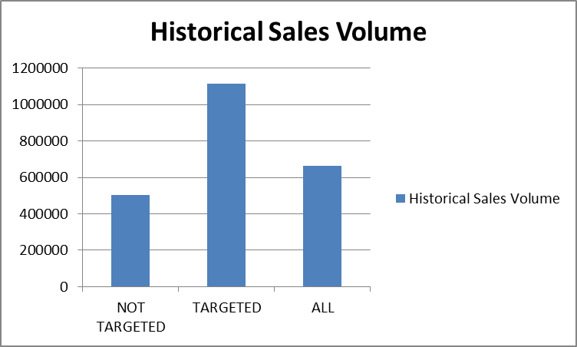
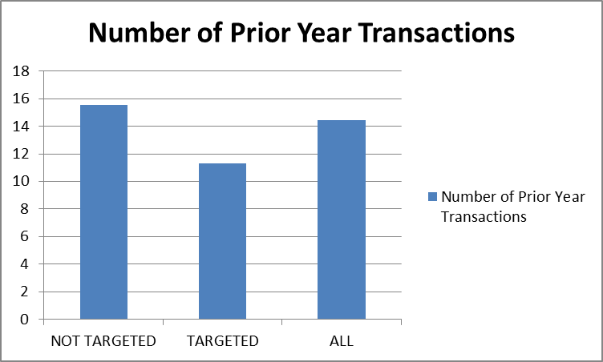
Office Corp trial campaign analysis
Selected Comparisons of Not Targeted, Targeted, and All

Slide 15
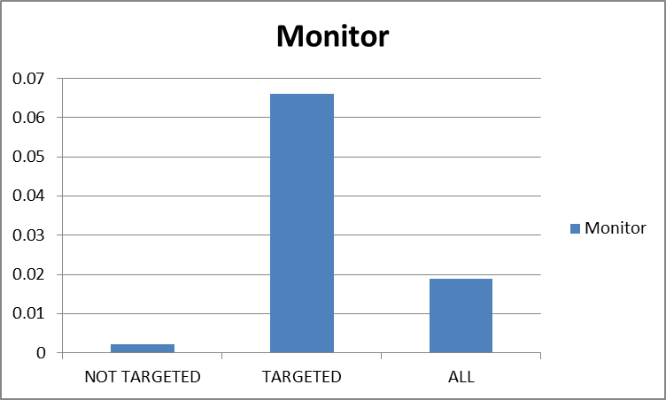
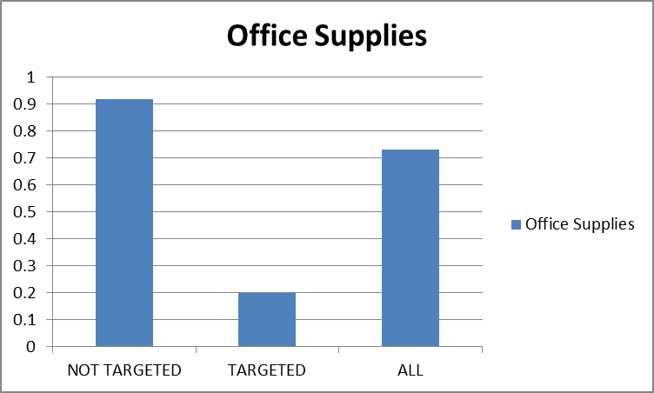
Office Corp trial campaign analysis
Selected Comparisons of Not Targeted,
Targeted, and All Cont.

Slide 16
Office Corp trial campaign analysis
Recommendations from this analysis
Recommendations from this analysis:
Target Model 1 Deciles 1 – 5
and Model 2 Deciles 1 and 2
Targeting has potential impact
on profit of $2,000,000
upon scaling up to 100k clients

Slide 17
Office Corp trial campaign analysis
Further future analysis:
Group customers by industry type to see if patterns emerge
Industry, Service, Consulting, Government
Answer the question: Would they have bought anyway?
To do so:
Analyze all sales for last 5 years to determine:
Expected Sales for each customer without campaign
Impact of Seasonality on Sales

Slide 18
Office Corp trial campaign analysis
Appendix 1 - Models
Appendix 1: Models
Model 1( Gradient Boosting Classifier): Predicts whether client will purchase
Model 2 (Linear Regression): – Predicts size of purchase
Data imported and cleaned
Data randomly split into three groups: Training (37.5%), Testing (37.5%), and Reserve (25%)
Model 1 is shaped by Training set
Model 2 is shaped by subset of same Training set: Actual Buyers
Model 1 Makes predictions on Testing set: To Buy or Not (80% accurate)
Model 2 is applied to Testing Data and predicts amount of sale
Expected Buyers are divided into Deciles based on Expected Sales Amount (which is accurate) and targeted
Expected Non Buyers are analyzed in attempt to catch False Negatives
Model 2 provides inaccurate Expected Sales Amount (far too high) for Expected Non Buyers
However, Model 2 accurately predicts the best buyers, and top two deciles are targeted as profitable.
Deciles and profitability are confirmed by running models on Reserve data as a final check.

Slide 19
Office Corp trial campaign analysis
Appendix 2: Comparison of Data
Appendix 2 - Analysis Results
Average
Targeted
Non Targeted
$5 Profit
$241 in campaign sales
$662k in historical sales vol
1.8% Purchased Monitor
Avg. of prior year
transactions: 14
$97 Profit
$660 in campaign sales
$1.3M in historical sales
vol
6.5% Purchased Monitor
Avg. of prior year
transactions: 11
$27 loss
$91 in campaign sales
$504k in historical sales
vol
0% Purchased Monitor
Avg. of prior year
transactions: 15

